Slide 1

Arizona Real Estate Pricing Predictive Modeling
TEAM 1

Slide 2




Team
Andrea Hernandez
Ryan Dekker
Daniela Trujillo
Necole Barnes

Slide 3


Introduction
In a post-pandemic world, with ever-changing market prices, the prediction of housing prices in various regions of Arizona can help guide a family in their search for a new home.
For this project, we will use U.S. housing listings from Zillow in 2023, specifically Arizona, to understand the relationships between various housing characteristics and the listed price for a home.
We aim to create a predictive model on housing prices to predict market prices in 2024.
Dataset: https://www.kaggle.com/datasets/febinphilips/us-house-listings-2023
https://www.zillow.com/research/data/

Slide 4
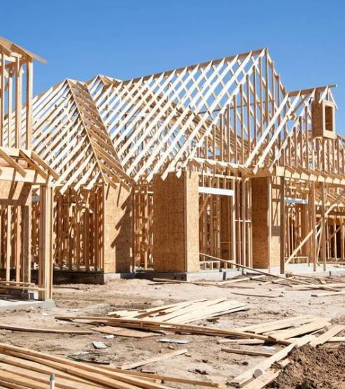

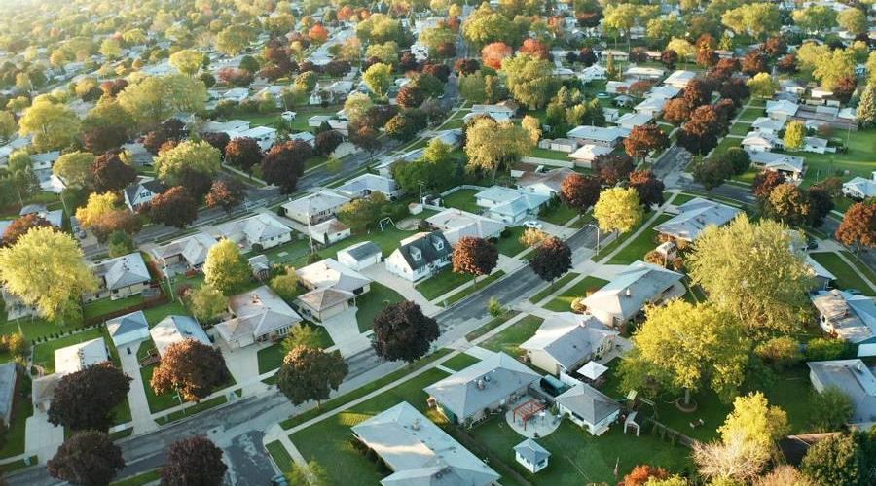
Research Questions
What are the differences in the cost of a home throughout the various regions of AZ?
By exploring the categorical and numerical variables, how does each variable affect the price per square foot and ultimate listing price?
What categorical and numerical variable best predicts the Zillow market price of a home?

Slide 5




Data Analytic Methods Used
Data Exploration, Cleanup, Visualizations
Predictive Modeling
Pandas
Tableau
Matplotlib
Numpy
Sql Alchemy
Scikit-learn
Statsmodels

Slide 6


Tableau Data Visualization
We uploaded our dataset into Tableau to visually explore the data and answer our first two research questions:
What are the differences in the cost of a home throughout the various regions of AZ?
By exploring the categorical variables, how does each variable affect the price per square foot and ultimate listing price?
In Tableau, we created four dashboards to combine into one story, with the main focus on the average Listed Price and average Price Per Square Foot for each city.
Project4_Arizona Properties 2023 | Tableau Public

Slide 7

Matplotlib Data Visualizations to explore the categorical variables throughout various regions of Arizona

Slide 8
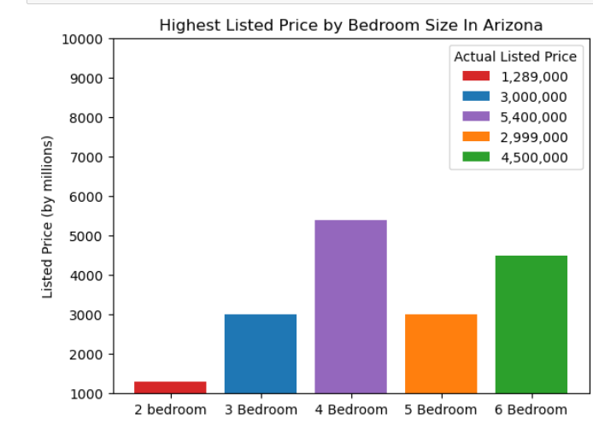
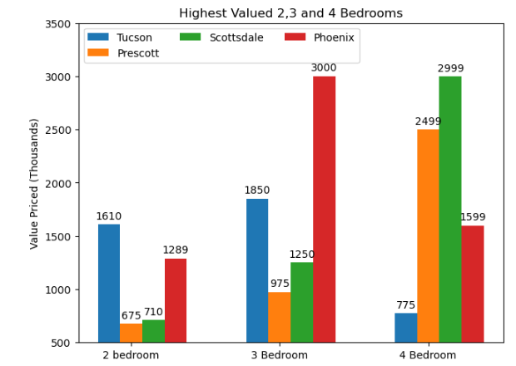
Categorical Variable Matplotlib Exploration
Highest Price Valued Homes in Arizona
By filtering the data set by Bedroom size we are able to compare Listed Price for Arizona and we also focused on the cities continuously growing like Tucson and Phoenix.

Slide 9
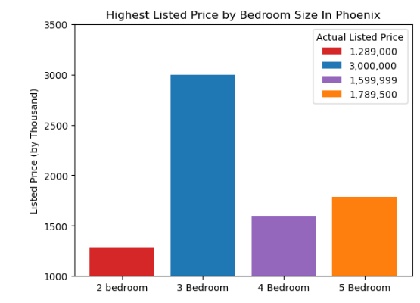
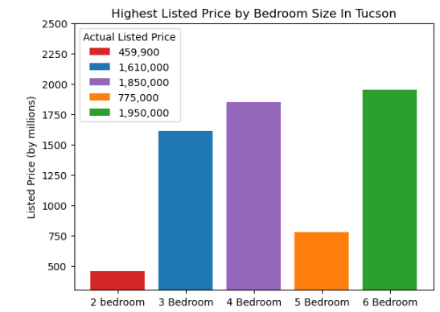
Continuously Growing Cities
Phoenix Listed Value Housing
Tucson Listed Value Housing

Slide 10
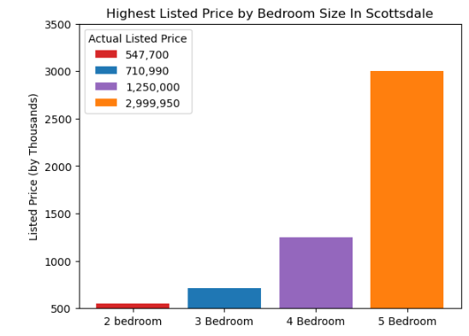
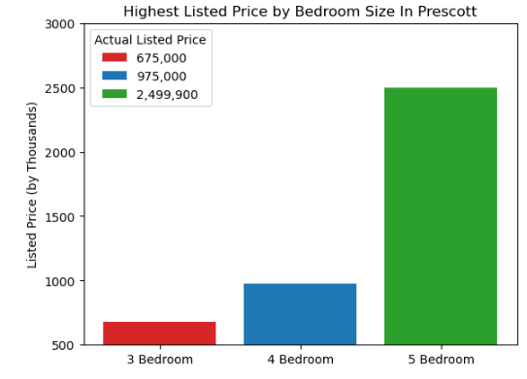
Other Cities
Scottsdale and Prescott are popular destinations for retirees

Slide 11
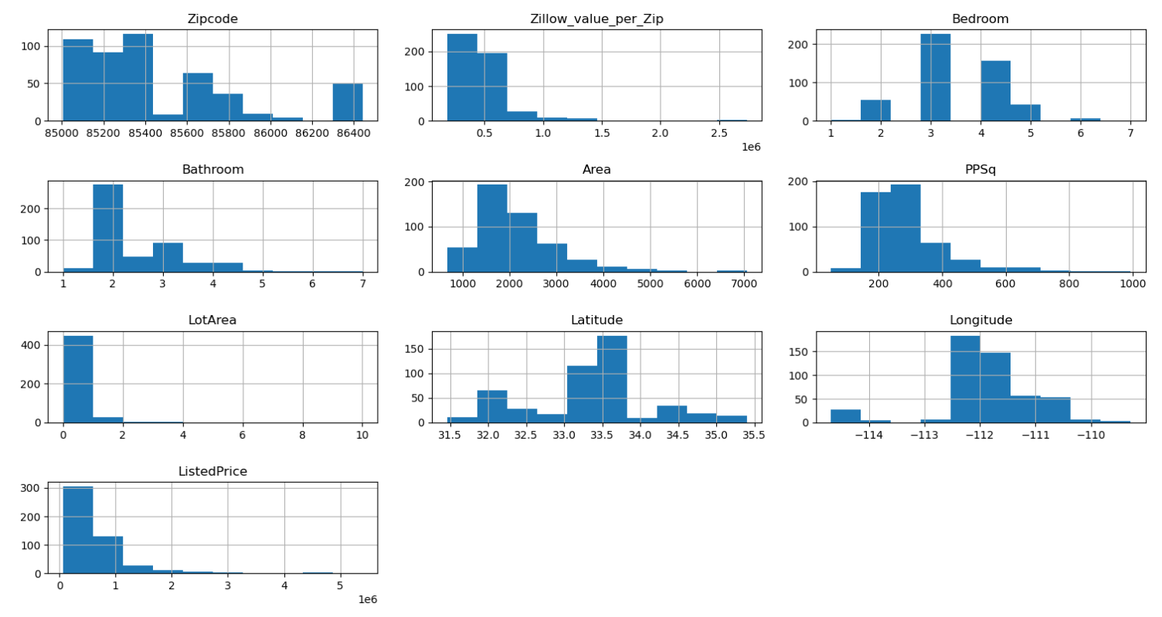
Histogram
Data is displayed by individual variables

Slide 12
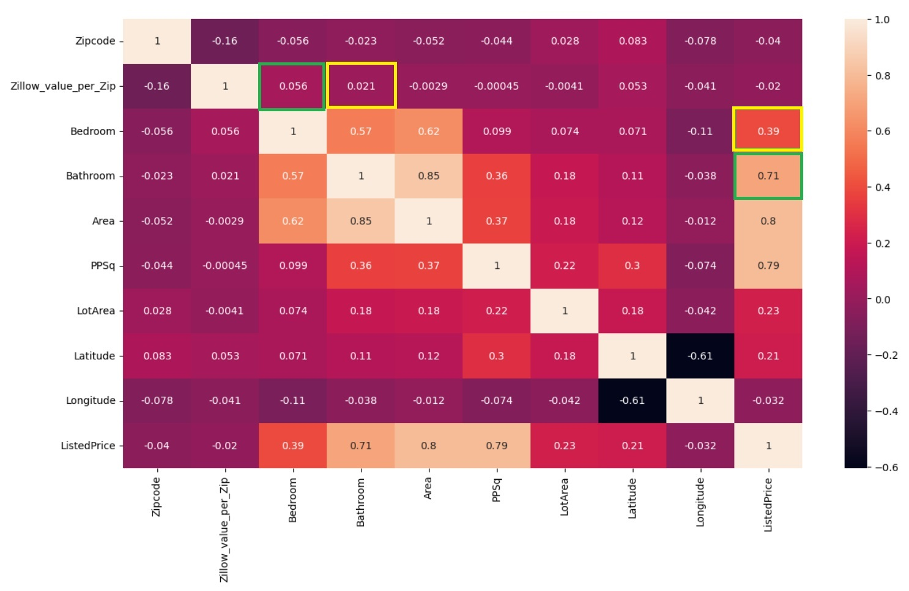
Heatmap Correlation
This visualization identified patterns and relationships between different variables in a dataset.

Slide 13
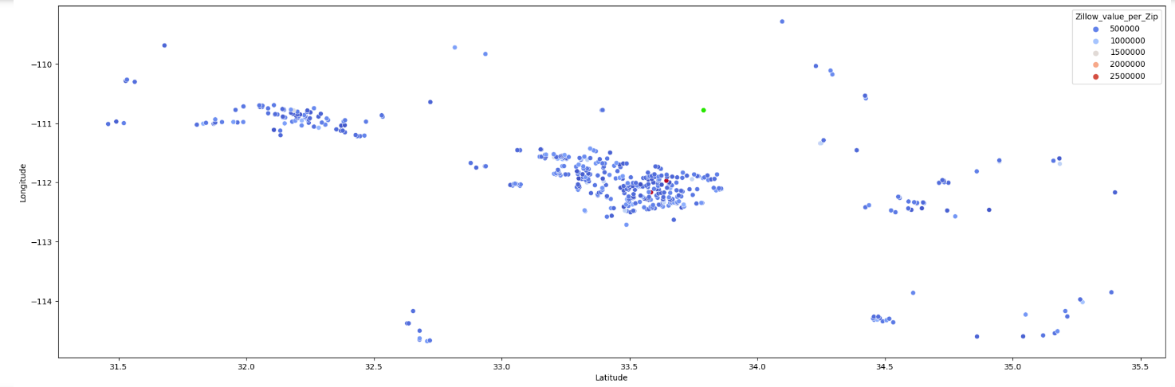
Scatterplot
Clustering indicates high activity, population centers, or area of interest.

Slide 14
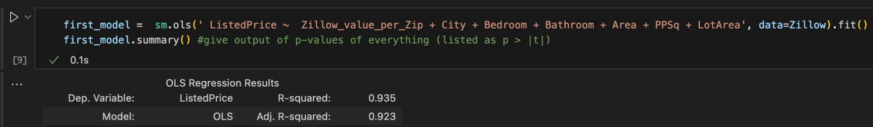
Data modeling the Zillow listings
Least Squares Regression
This first model uses all the independent variables to have an R-squared of 0.935 (out of 1)

Slide 15
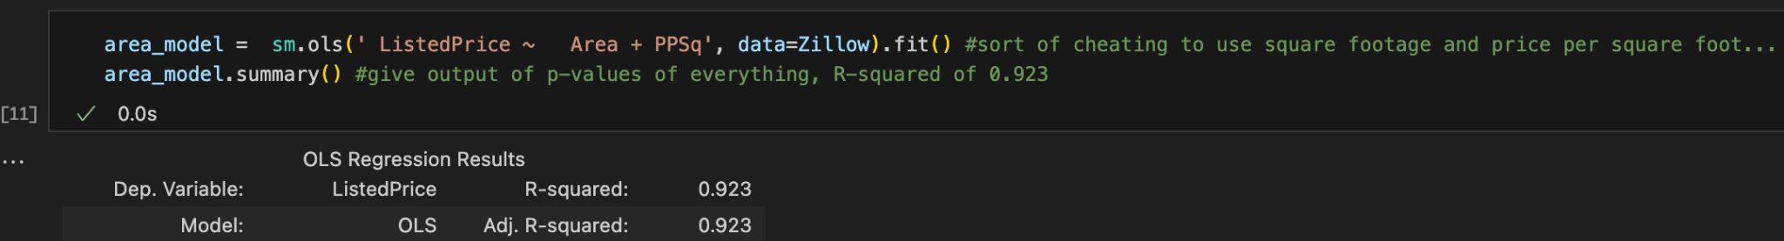
Data modeling the Zillow listings
Least Squares Regression
However, the “PPsq” or price per square foot naturally does a lot of the heavy lifting here, so let’s see if we can find other strong predictors for real estate values…

Slide 16
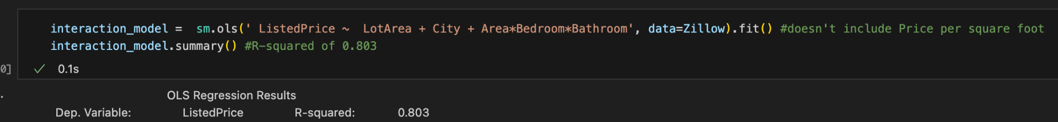
An interaction model
Least Squares Regression
We get an R-squared over 0.8 using the plot size, City, square footage, and number of bedrooms/bathrooms

Slide 17
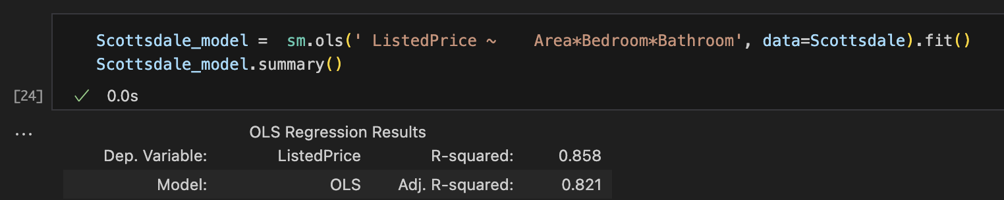
Just Scottsdale
Least Squares Regression
We get an R-squared over 0.8 using the square footage, and number of bedrooms/bathrooms

Slide 18
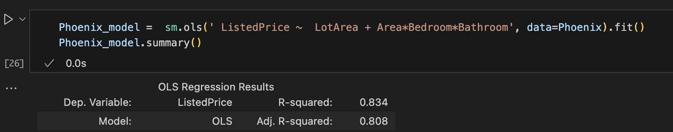
Just Phoenix
Least Squares Regression
Phoenix needed the plot size in order to reach the significance threshold, so there’s likely more variance here than compared to Scottsdale
We get an R-squared over 0.8 using the plot size, square footage, and # of bedrooms/bathrooms

Slide 19
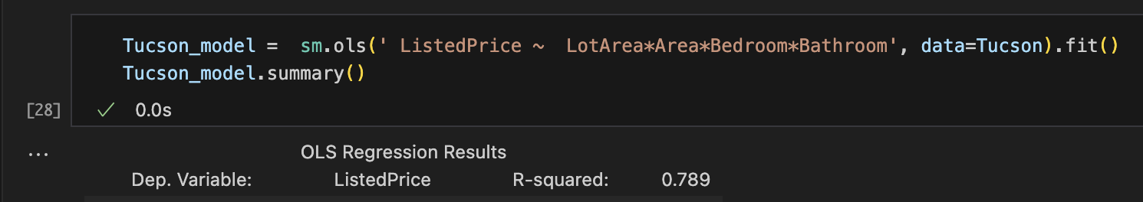
Just Tucson
Least Squares Regression
Narrowly misses the threshold for significance but it’s close. Maybe if we had more data, the model could be improved

Slide 20
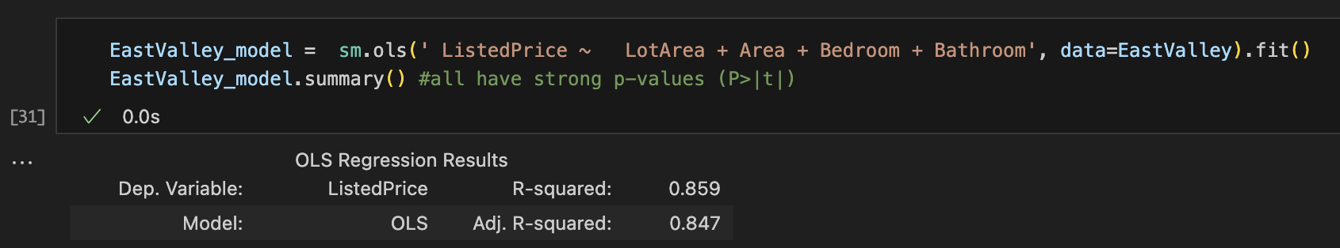
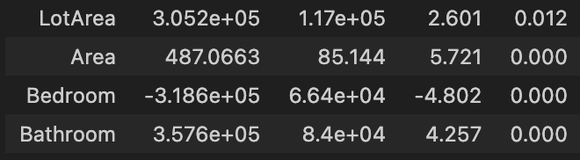
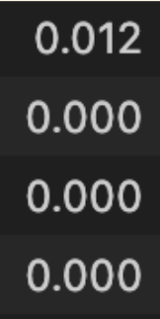

Just East Valley (Mesa, Tempe, Chandler, Gilbert)
Least Squares Regression
← All these predictors have p-values that are close to zero.
These similar suburb cities were able to have the best model so far

Slide 21
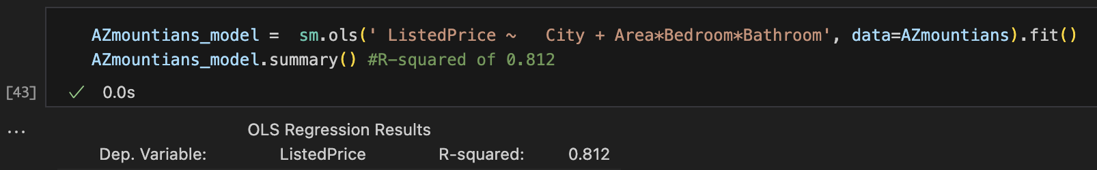
The mountainous areas (Prescott, Payson, Sedona, Flagstaff)
Least Squares Regression
The Uplands could reach this threshold, but “City” is still significant, so one mountain town isn’t similar to all.

Slide 22
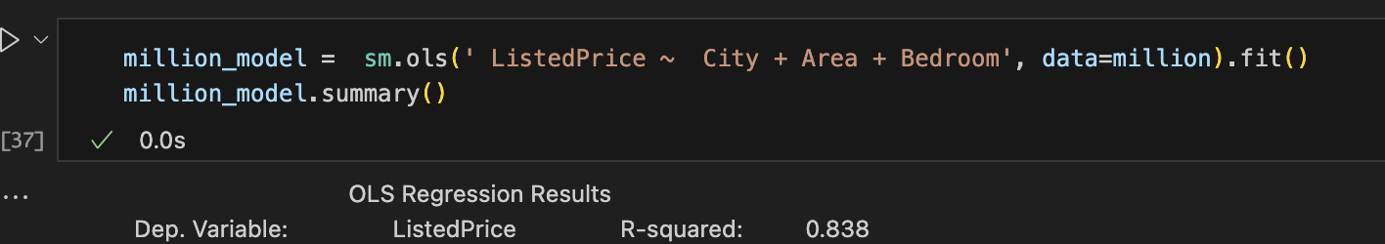
Just listings over a million dollars
Least Squares Regression
City still matters for listings over $1,000,000. Square footage was the strongest predictor, with a p-value listed as “0.000”. Number of bedrooms also included.

Slide 23
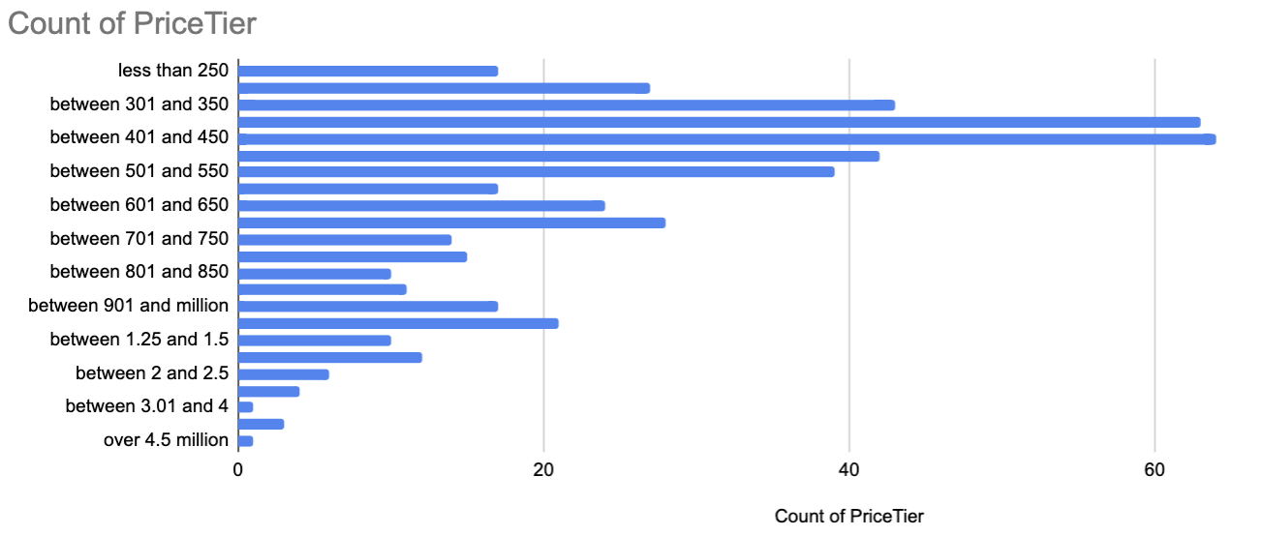
Predicting the price tiers
A wide spread here, as expected…

Slide 24
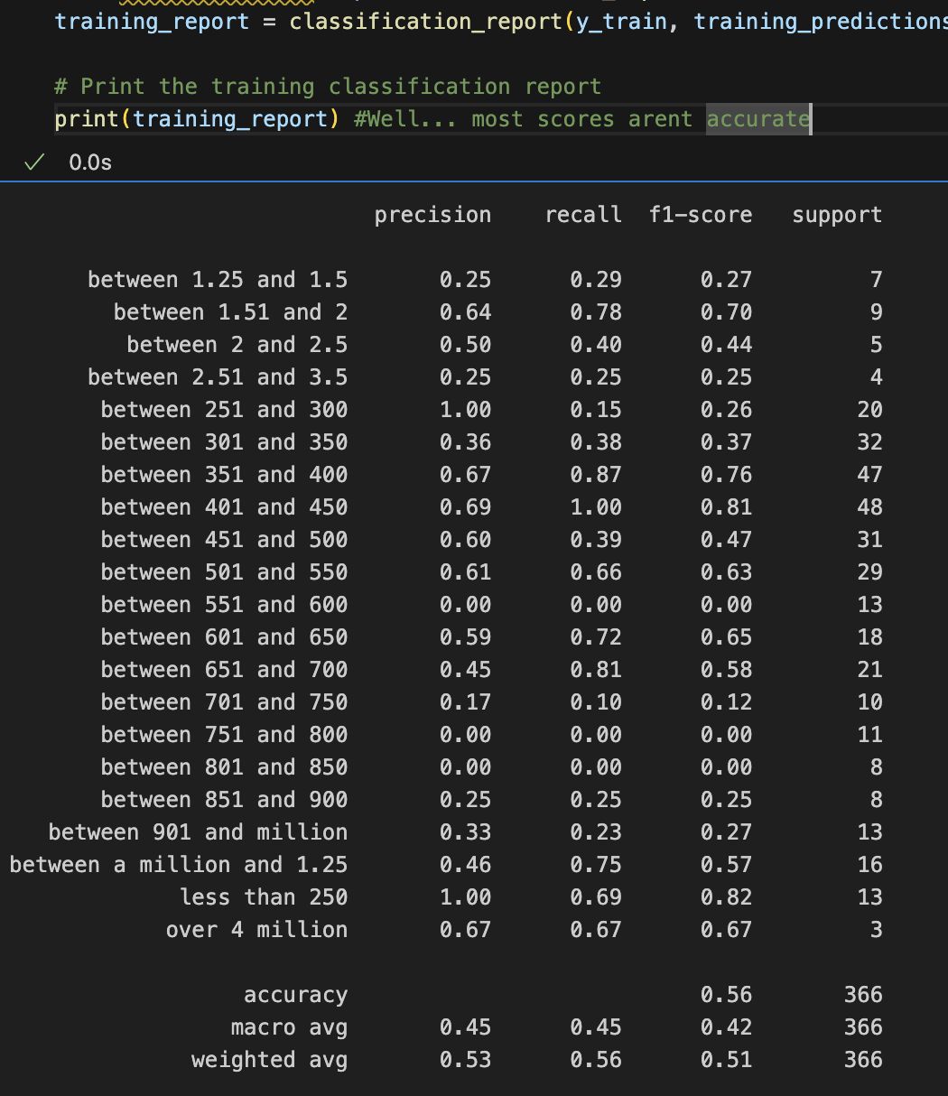
Predicting the price tiers
With so many tiers, it had trouble modeling this skewed data
It only got a few of these tiers well (those with the larger sample size)
It’s weighted average is only 0.51, so the model could possibly benefit from different binning or more data.

Slide 25
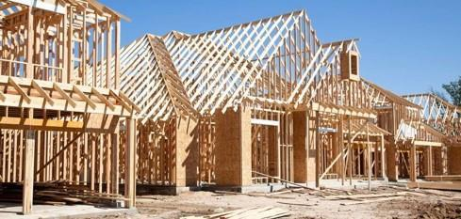

Summary
This Zillow data showed a wide range of prices for the listings, but several factors repeatedly showed themselves to be significant
# of bedrooms and bathrooms,
Square footage of the home was more important than lot size
City was an important factor, but these data were able to be successfully modeled when grouping these listings into relevant categories
Tucson
Scottsdale
East Valley (Mesa, Tempe, Chandler, Gilbert)
Uplands (Prescott, Payson, Sedona, Flagstaff)

Slide 26




Thank you

